Slide 1
Grillage Method of Superstructure Analysis
Dr. Shahzad Rahman
NWFP University of Engg & Technology, Peshawar
Sources: Lecture Notes Prof. Azlan Abdul Rehman, University Teknologi Malaysia
Lecture Notes Prof. M S Cheung, Hong Kong University

Slide 2
Description – Grillage Method of Analysis
Essentially a computer-aided method for analysis of bridge decks
The deck is idealized as a series of ‘beam’ elements (or grillages), connected and restrained at their joints.
Each element is given an equivalent bending and torsional inertia to represent the portion of the deck which it replaces.
Bending and torsional stiffness in every region of slab are assumed to be concentrated in nearest equivalent grillage beam.
Restraints, load and supports may be applied at the joints between the members, and members framing into a joint may be at any angle.

Slide 3
Description
Slab longitudinal stiffness are concentrated in longitudinal beams; transverse stiffness in transverse beams.
Equilibrium in slab requires torque to be identical in orthogonal directions.
Twist is same in orthogonal directions but not in equivalent grillage unless the mesh is very fine.

Slide 4
Basic Theory
Basic theory includes the displacement of Stiffness Method.
Essentially a matrix method in which the unknowns are expressed in terms of displacements of the joints.
The solutions of the problem consists of finding the values of the displacements which must be applied to all joints and supports to restore equilibrium.

Slide 5
Grillage Analysis Program
Some computer programs allow elastic restraints to be input at joints to simulate the effect of rubber bearings or elastic shortening of columns under load.
It is possible to analyze any two-dimensional deck structure with any support conditions or skew angle (up to about 20º). It is normally required to smooth out the discontinuities at the imaginary joints between grillage members.
The method can be extended to cater for three dimensional systems (space-frame analysis).

Slide 6
Grillage Analysis Program
When a bridge deck is analyzed by the method of Grillage Analogy, there are essentially five steps to be followed for obtaining design responses :
Idealization of physical deck into equivalent grillage
Evaluation of equivalent elastic inertia of members of grillage
Application and transfer of loads to various nodes of grillage
Determination of force responses and design envelopes and
Interpretation of results.

Slide 7
Grillage Analysis Program
The method consists of converting the bridge deck structure into a network of rigidly connected beams or into a network of skeletal members rigidly connected to each other at discrete nodes i.e. idealizing the bridge by an equivalent grillage.
The deformations at the two ends of a beam element are related to a bending and torsional moments through their bending and torsion stiffness.
The Structure Stiffness matrix is formed using the usual techniques of Matrix Structural Analysis or the Finite Element

Slide 8
Grillage Analysis Program
The moments are written in terms of the end-deformations employing slope deflection and torsional rotation moment equations.
The shear force in the beam is also related to the bending moment at the two ends of the beam and can again be written in terms of the end deformations of the beam.
The shear and moment in all the beam elements meeting at a node and fixed end reactions, if any, at the node, are summed up and three basic statical equilibrium equations at each node namely ΣF_{Z} = 0, ΣM_{z}= 0 and ΣM_{y}= 0 are satisfied.

Slide 9
Grillage Analysis Program
The bridge structure is very stiff in the horizontal plane due to the presence of decking slab. The transitional displacements along the two horizontal axes and rotation about the vertical axis will be negligible and may be ignored in the analysis.
Thus a skeletal structure will have three degrees of freedom at each node i.e. freedom of vertical displacement and freedom of rotations about two mutually perpendicular axes in the horizontal plane.
In general, a grillage with n nodes will have 3n degrees of freedom or 3n nodal deformations and 3n equilibrium equations relating to these.

Slide 10
Grillage Analysis Program
All span loading are converted into equivalent nodal loads by computing the fixed end forces and transferring them to global axes.
A set of simultaneous equations are obtained in the process and their solutions result in the evaluation of the nodal displacements in the structure.
The member forces including the bending & the torsional moments can then be determined by back substitution in the slope deflection and torsional rotation moment equations.

Slide 11
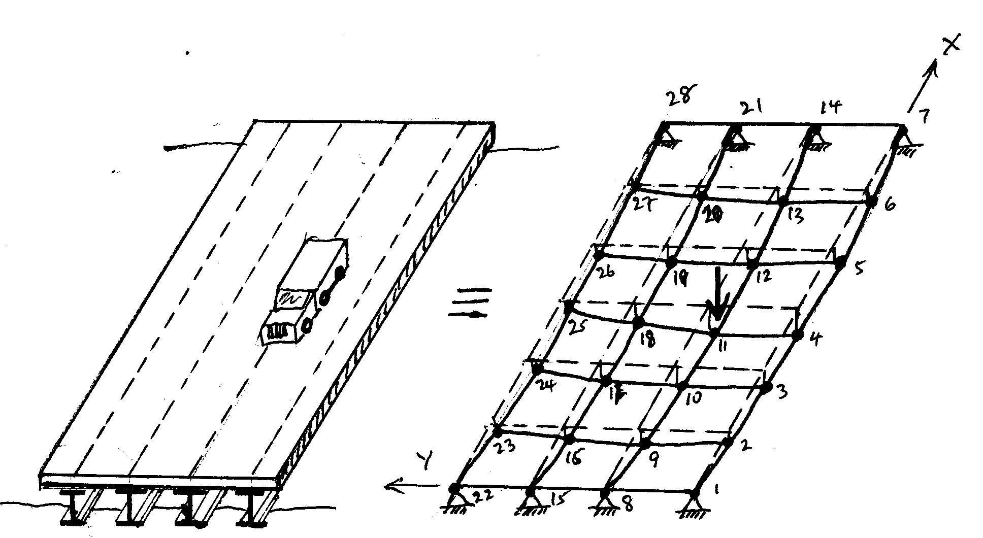
Grillage Mesh
Bridge Deck Idealized Model (Deflected)

Slide 12
Slab Idealization – Location & Spacing of Grillage Members
The logical choice of longitudinal grid lines for T-beam or I-beams decks is to make them coincident with the centre lines of physical girders and these longitudinal members are given the properties of the girders plus associated portions of the slab, which they represent. Additional grid lines between physical girders may also be set in order to improve the accuracy of the result.
Edge grid lines may be provided at the edges of the deck or at suitable distance from the edge.
For bridge with footpaths, one extra longitudinal grid line along the centre line of each footpath slab is also provided. The above procedure for choosing longitudinal grid lines is applicable to both right and skew decks.

Slide 13
Slab Idealization – Location & Spacing of Grillage Members
When intermediate cross girders exists in the actual deck, the transverse grid lines represent the properties of cross girders and associated deck slabs.
The grid lines are set in along the centre lines of cross girders. Grid lines are also placed in between these transverse physical cross girders, if after considering the effective flange width of these girders portions of the slab are left out.
If after inserting grid lines due to these left over slabs, the spacing of transverse grid lines is still greater than two times the spacing of longitudinal grid lines, the left over slabs are to be replaced by not one but two or more grid lines so that the above recommendation for spacing is satisfied

Slide 14
Slab Idealization – Location & Spacing of Grillage Members
When there is a diaphragm over the support in the actual deck, the grid lines coinciding with these diaphragms should also be placed.
When no intermediate diaphragms are provided, the transverse medium i.e. deck slab is conceptually broken into a number of transverse strips and each strip is replaced by a grid line.
The spacing of transverse grid line is somewhat arbitrary but about 1/9 of effective span is generally convenient. As a guideline, it is recommended that the ratio of spacing of transverse and longitudinal grid lines be kept between 1 and 2 and the total number of lines be odd.
This spacing ratio may also reflect the span width ratio of the deck. Therefore, for square and wider decks, the ratio can be kept as 1 and for long and narrow decks, it can approach to 2.

Slide 15
Slab Idealization – Location & Spacing of Grillage Members
The transverse grid lines are also placed at abutments joining the centre of bearings.
A minimum of seven transverse grid lines are recommended, including end grid lines.
It is advisable to align the transverse grid lines normal to the longitudinal lines wherever cross girders do not exist.
It should also be noted that the transverse grid lines are extended up to the extreme longitudinal grid lines.

Slide 16
Slab Idealization – Location & Spacing of Grillage Members
In skew bridges, with small skew angle say less than 15º and with no intermediate diaphragms, the transverse grid lines are kept parallel to the support lines.
Additional transverse grid lines are provided in between these support lines in such a way that their spacing does not exceed twice the spacing of longitudinal lines, as in the case of right bridges, discussed above.
In skew bridges, with higher skew angle, the transverse grid lines are set along abutments.

Slide 17
Slab Idealization – Location & Spacing of Grillage Members
􀂄Summary of some general selection guidelines
  􀂄a) Put grillage along line of strength (pre-stress beams, edge beams, etc.)
  􀂄 b) Consider how the forces flow in the slab
  􀂄 c) Place edge grillage member closely to the
Resultant of the vertical shear flow at edge of
The deck., i.e. for a solid slab, this is about 0.30
of depth from the edge.

Slide 18
Skew Decks
Orientation of longitudinal members should always be parallel to the free edges.
Transverse members should be parallel to the supports with the structural parameters calculated using orthogonal distance between grillage members; or orthogonal to the longitudinal beams.

Slide 19
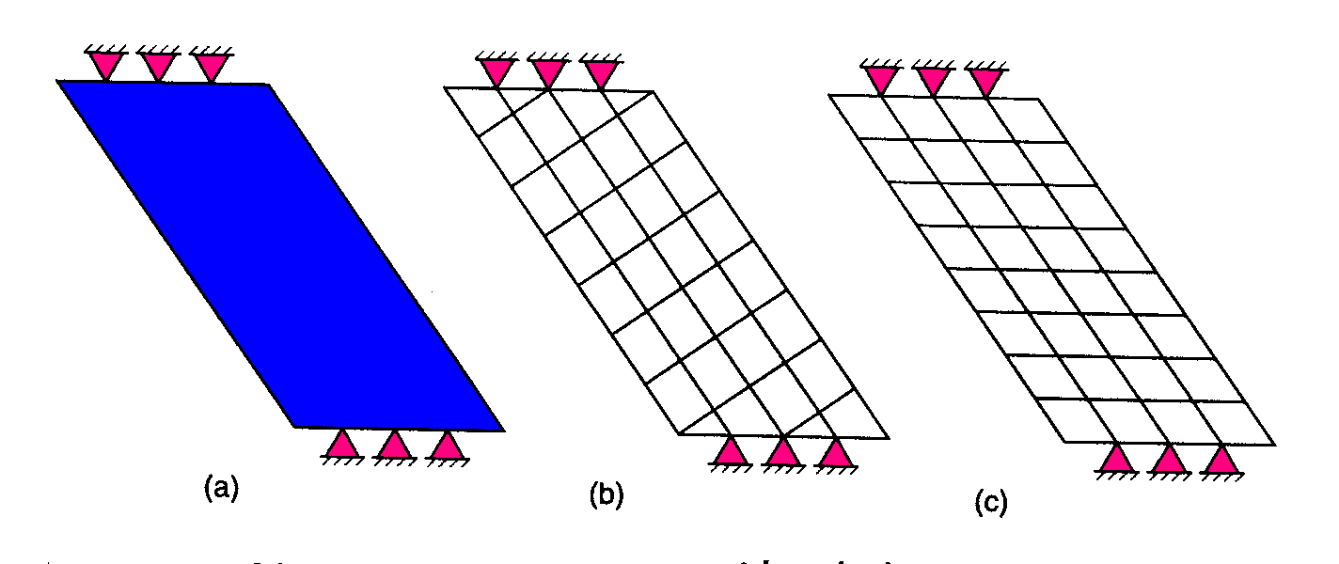
Possible grillage arrangement for skewed decks
Long, narrow, highly skewed bridge deck.
(a) plan view (b) grillage mesh (c ) alternative mesh

Slide 20
Slab Idealization – Bending & Torsional Inertia of Grillage Members
For the purpose of calculation of flexural and torsional inertia, the effective width of slab, to function as the compression flange of T-beam or L-beam is needed. A rigorous analysis for its determination is extremely complex and in absence of more accurate procedure for its evaluation, some recommendations given that the effective width of the slab should be the least of the following :
In case of T-beams
One fourth the effective span of the beam
The distance between the centres of the ribs of the beams
The breadth of the rib plus twelve times the thickness of the slab.
In case of L-beams
One tenth of the effective span of the beam
The breadth of the rib plus one had the clear distance between the ribs.
The breadth of the rib plus six times the thickness of slab.

Slide 21
Slab Idealization – Bending & Torsional Inertia of Grillage Members
The flexural inertia of each grillage member is calculated about its centroid.
Often the centroids of interior and edge member sections are located at different levels. The effect of this is ignored as the error involved is insignificant.
Once the effective width of slab acting with the beam is decided, the deck is conceptually divided into number of T or L-beams as the case may be.
Some portion of the slab may be left over between the flanges of adjacent beams in either directions.
In the longitudinal direction, it is sufficient to consider the effective flange width of T, L or composite sections, in order to account for the effects of shear lag and ignore the left over slab.
However, in the transverse direction, the left over slab should be considered by introducing additional grid lines at the centre of each left over slab portion.

Slide 22
Torsion Shear Flow
0.3d (solid slab)
d
Position of grillage beams depends on position of torsion shear flow.
This should be close to the resultant of vertical shear flow at edge of deck.

Slide 23
Spacing of Grillage Members
Total number of longitudinal members varies depending on width of deck.
Spacing < 2d to 3d
> ¼ (effective span) for isotropic slabs
Spacing of transverse members should be enough to represent loads distributed along longitudinal members.
Closer spacing required in regions of sudden change (e.g. internal supports)
In general transverse members should be perpendicular to longitudinal grillage members (even for skew bridges < 20º)

Slide 24
Spacing of Grillage Members
The spacing of transverse grillage members are chosen to be about 1.5 times the spacing of the main longitudinal members, but may vary up to a limit of 2:1.
Transverse members are required at the diaphragm positions and, in order to achieve a member at mid span, there needs to be an odd number of members.

Slide 25
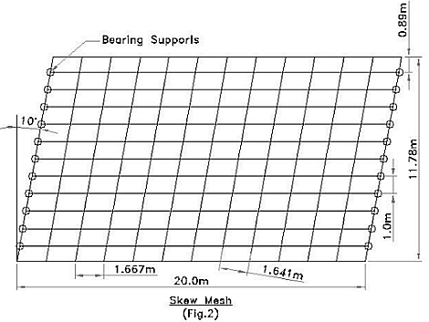
Spacing of Grillage Members
For Small Skew Angle (less than 35º) Skew Mesh may be adopted without loss of much accuracy as shown below.

Slide 26
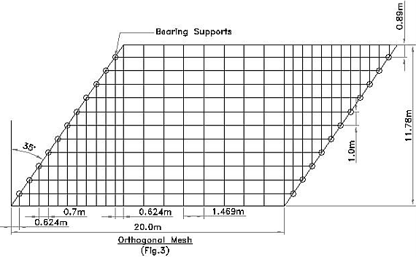
Spacing of Grillage Members
For Skew Angles greater than 35º) Orthogonal Mesh should be adopted to get accurate response as shown below.

Slide 27

Grillage Mesh for Beam & Slab Decks
Without midspan diaphragm, spacing of transverse grillage members arbitrary 1/4/ to 1/8 of effective span. Spacing <1/10 span.
With diaphragm (e.g. over support), grillage members should be coincident.
Flexural inertia of each grillage member is calculated about the centroid of each section it represents.

Slide 28
Sectional Properties of Grillage Members
The section properties of grid lines representing the slab only are calculated in the usual way
i.e. I = bd³/12 and J=bd³/6.
If the construction materials have different properties in the longitudinal and transverse directions, care must be taken to apply correction for this.
For example, in a reinforced concrete slab on precast prestressed concrete beams or on steel beams, the inertia of the beam element ( I or J) is multiplied by the ratio of moduli of elasticity of beam E_{b} and also E_{s} materials to convert it into the inertia of slab material.

Slide 29
Solid Slab – subdivision of slab deck cross-section for longitudinal grillage beams
b1
b2
b3
b4
b5
b6
d

Slide 30
Voided slab
d
Longitudinal beams – for shaded region about NA
Transverse beams – at CL of void
Void diameter < 60% of d, then transverse inertia equals longitudinal inertia

Slide 31
Torsion
Torsion constant per unit width of slab is given by c = d³/6 per unit width
For a grillage beam representing width b of slab, C = bd³/6 where C ≈ 2I
Huber’s approximation, c = 2 √ (i_{x}.i_{y})
Where i_{x}.i_{y} = longitudinal and transverse member inertia per unit width of slab
At edges, in calculation of c, width of edge member is reduced to (b-0.3d)

Slide 32
Example – Solid Slab
20m span, simply supported, right bridge
Solid slab deck 12m wide, 1.0m thick
12.0
1.0
0.3
0.3
1.8
2.8
2.8
2.8
1.8

Slide 33
supports
y
1.42
2.86
Slab is isotropic
i_{x} = i_{y} = 1.0³/12 = 0.0834 per m
c_{x} = c_{y} = 1.0³/6 = 0.167 per m
2.86
2.86
20m
2.86
2.86
2.86
1.42
x
supports

Slide 34
Internal Longitudinal Grillage Members
1.0
2.8
I_{x} = 2.8 x 0.0834 = 0.233
C_{x} = 2.8 x 0.167 = 0.466

Slide 35
Edge Longitudinal Grillage Members
0.3
1.0
1.8
I_{x} = 1.7 x 0.0834 = 0.142
C_{x} = (1.8 – 0.3) x 0.167 = 0.2505

Slide 36
Transverse Grillage Members
Span 20.0
1.0
0.3
0.3
1.42
2.86
2.86
2.86
2.86
2.86
2.86
1.42

Slide 37
Internal Transverse Grillage Members
1.0
2.86
I_{x} = 2.86 x 0.0834 = 0.239
C_{x} = 2.86 x 0.167 = 0.477

Slide 38
Edge Transverse Grillage Members
0.3
1.0
1.42
I_{x} = 1.42 x 0.0834 = 0.118
C_{x} = (1.42 – 0.3) x 0.167 = 0.187

Slide 39
Application of Loads in Grillage Analysis Programs
Programs vary regarding the types of load that can be applied to the structure.
All will permit the application of point loads and moments at the joints.
Some programs allow point loads, distributed loads and moments to be applied on the members.

Slide 40
Application of Loads in Grillage Analysis Programs
Loads may be applied as joint loads
Alternately, distributed Loads may be applied to Grillage Elements/
e.g. Vertical load from HB acting at X within a quadrilateral formed by grillage members
Equivalent load Q_{i} = P_{i}
(1/a) + (1/b) + (1/c) + (1/d)
where a, b, c, d are distances of the loads measured from the corners.
i may be a, b, c, or d.

Slide 41
Application of Loads in Grillage Analysis Programs
a
b
Equivalent load
Q_{i} = P_{i}
(1/a) + (1/b) + (1/c) + (1/d)
Point X
c
P
d

Slide 42
Application of Loads in Grillage Analysis Programs
Vertical load P acting at point X within a triangle formed by grillage members
Equivalent load
Q_{i} = P_{i}
(1/a) + (1/b) + (1/c)
Nodal load at D,y =
Qd + Rg
(d + e) (f + g)
d
C
A
c
a
x
b
e
g
B
f
D
y

Slide 43
Rough Guidelines for Deck Idealization in Grillage Analysis
Grid lines are placed along the centre line of the existing beams, if any and along the centre line of left over slab, as in the case of T-girder decking.
Longitudinal grid lines at either edge be placed at 0.3D from the edge for slab bridges, where D is the depth of the deck.
Grid lines should be placed along lines joining bearings.
A minimum of five grid lines are generally adopted in each direction.
Grid lines are ordinarily taken at right angles.

Slide 44
Rough Guidelines for Deck Idealization in Grillage Analysis
Grid lines in general should coincide with the CG of the section. Some shift, if it simplifies the idealisation, can be made.
Over continuous supports, closer transverse grids may be adopted. This is so because the change is more depending upon the bending moment profile.
For better results, the side ratios i.e. the ratio of the grid spacing in the longitudinal and transverse directions should preferably lie between 1.0 to 2.0.

Slide 45
Interpretation of Output – some guidelines
In beam and slab decks, the stepping of moments in members on either side of a node occurs. The difference in bending moments in two adjacent members meeting at a node will generally be large in outer girders.
In the case where all the members meeting at the node are physical beams, the actual values of bending output from the program is to be used.

Slide 46
Interpretation of Output – some guidelines
If at a node there are no physical beams in the other direction and the grid beam elements represent a slab, the bending moments on either side of the node should be averaged out, as there are no real beams of any significant torsional strength.
The design shear forces and torsions can be read directly from grillage output without any modifications.

Slide 47
Interpretation of Output – some guidelines
In case of composite constructions, where the grillage member stiffnesses are calculated from properties of two dissimilar materials of slab and beam elements, the output force response is attributed to each in proportion to its contribution to the particular stiffness.
In cases where there are no nominal grillage members between two physical beams and the transverse members have not been loaded, then for these moments can be read directly from the grillage output for the local transverse members.

Slide 48
Interpretation of Output – some guidelines
In case there is a nominal grillage member under the load or if the transverse members have been loaded, the slab moments due to twisting of beams can be calculated from the grillage output displacements and rotations of adjacent beams by using slope deflection method.

Slide 49
Interpretation of Output – some guidelines
If the longitudinal grid lines are not physically supported at the ends, the load carried by these lines is taken to flow towards nearby supports through the end cross girders.
In case this is not accounted for, then this result in lower values of shear in supported grid lines. To account for this under estimation, the shear of these beams is to be added to the shear of adjacent beams, which are physically supported.
In the same way, to avoid under estimation of bending moment in supported longitudinal beams, the bending moments of unsupported grid lines should also be considered in the design of supported longitudinal beams.

Slide 50
Example – grillage analysis
Solid deck bridge with effective span 5.4m
Slab thickness 400mm, edge beam 700mmx380mm
Carriageway 7.4m wide with 11º skew
7.4m (carriageway width)
0.38
0.70
0.40
0.91
0.90
0.90
0.90
0.90
0.90
0.90
0.91

Slide 51
Z
Span direction
Effective span 5.4m
(0.9m x 6)
7
14
63
Skew angle
11º
X
origin
1
8
57
1.0304
0.91
0.90
0.90
0.90
0.90
0.90
0.90
0.91

Slide 52
Properties of longitudinal grillage members
0.90
For internal members
Ix = 0.9(0.4)³/12= 0.0048 m⁴
Cx = 0.9(0.4)³/6 = 0.0096m⁴
For edge members
Ix = 0.01646 m⁴
Cx =0.016 m⁴
0.40
Internal members
0.38
0.70
0.40
0.94
edge members

Slide 53
Properties of transverse grillage members
0.90
For internal members
Ix = 0.9(0.4)³/12= 0.0048 m⁴
Cx = 0.9(0.4)³/6 = 0.0096m⁴
For edge members
Ix = 0.6(0.4)³/12 = 0.0032 m⁴
Cx = 0.6(0.4)3/6 = 0.0064 m⁴
0.40
Internal members
0.40
0.60
edge members

Slide 54
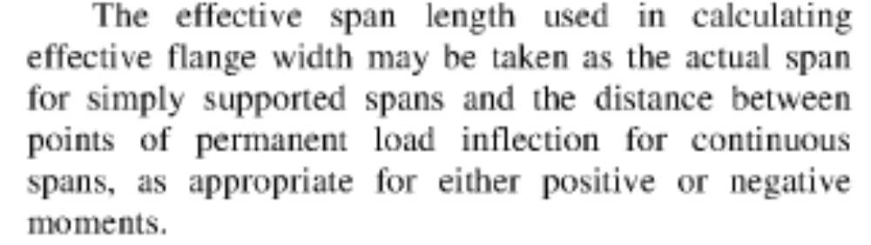
Effective Flange Widths of Beams For Grillage Analysis
d
bno
bno
c

Slide 55
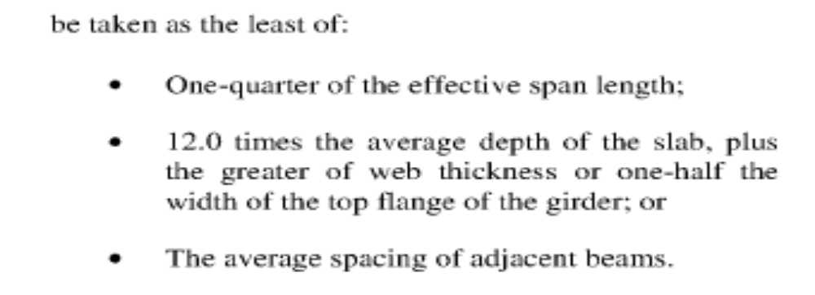
Effective Flange Widths of Beams For Grillage Analysis
d
bno
bno
c

Slide 56
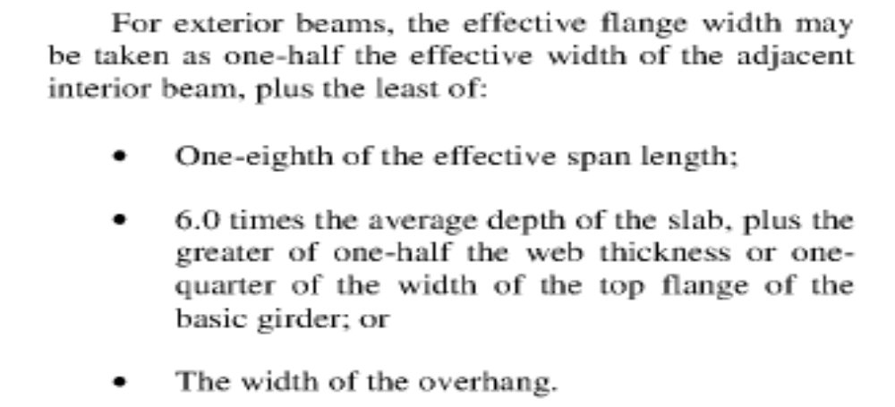
Effective Flange Widths of Beams For Grillage Analysis
d
bno
bno
c

Slide 57
Loading Input – lane loading for 5.4m span
4.93m
2.47m
2/3 HA-UDL
1/3 HA-UDL
0.91
0.90
0.90
0.90
0.90
0.90
0.90
0.91
Lane loading for 5.4m span = 31.98 kN/m
Width of notional lane = 7.4/3 = 2.467m
Lane loading = 31.98 x 2.467/3 = 26.29 kN/m

Slide 58
HA Loading - 1/3 HA Over Whole Deck
1 lane with 1/3 HA loading = 47.322 kN
3 lanes with 1/3 HA loading = 47.322x3 = 141.966 kN
Area of grillage deck under HA loading = 7.22cos11º x 5.4 = 38.27 m²
Load per unit area = 141.966/38.27 = 3.709 kN/m².

Slide 59
HA Loading – 2/3 HA over 2 Notional Lanes
1 lane with full HA loading = 26.29 x 5.4 kN
= 141.966 kN
1 lane with 2/3 HA loading = (2/3)141.966
= 94.644 kN
2 lanes with 2/3 HA = 2 x 94.644 = 189.288 kN
Grillage area of 2 loaded lanes = (4.843cos11º)5.4
= 25.672 m²
Load per unit area = 189.288/25.672 = 7.373 kN/m²
Total HA = 141.966 + 189.288 = 331.254 kN
Grillage deck area = 5.4(7.22cos11º) = 38.272m²

Slide 60
AASHTO Distribution Factor Method
The Bridge is Analyzed as a Simple Beam
The individual bending moments and shears in each girder is estimated by multiplying the total span moment/shear with Distribution Factors
The Distribution Factors are given in Tables 4.6.2.2.2b1 and 4.6.2.2.2d1 In AASHTO LRFD Code
The Distribution Factors have been determined from fitting equations to the results of Refined Analyses of over 200 Bridges of various configurations

Slide 61
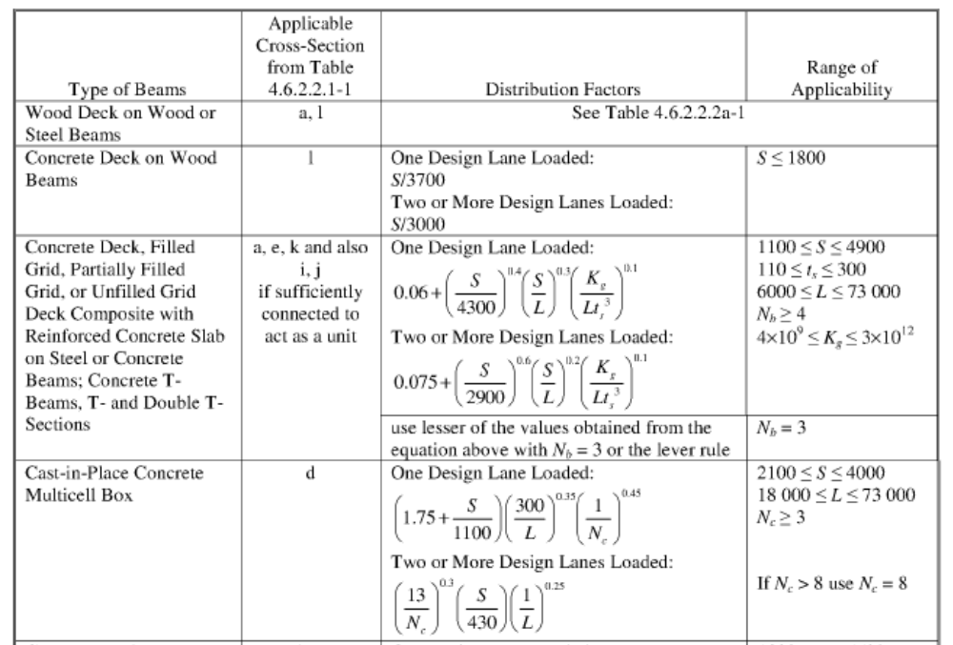
AASHTO Distribution Factor Method

Slide 62
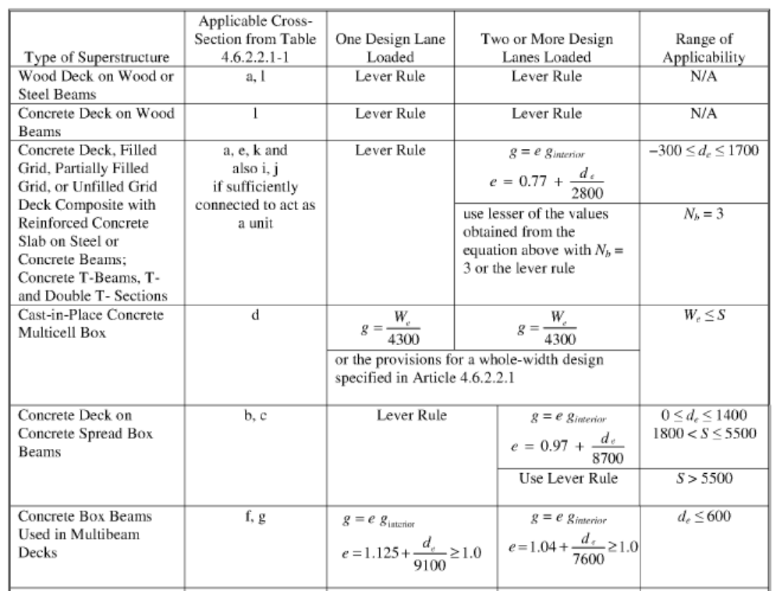
AASHTO Distribution Factor Method

